Slide 1
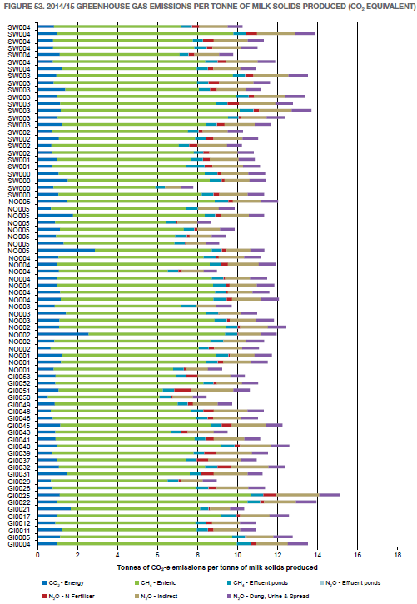
Greenhouse Gas Emissions Data
What is this data?
What does it tell us?
How is it used?

Slide 2
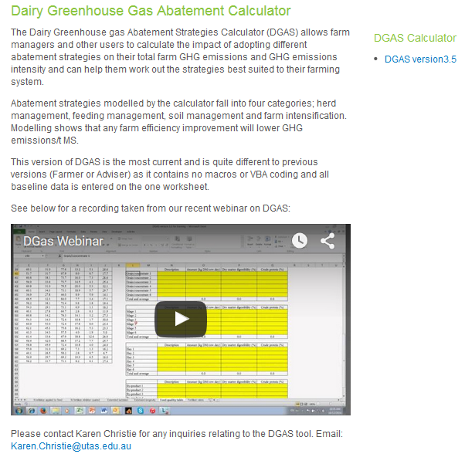
What is the data?
How do we estimate GHG emissions on Australian dairy farms?
DGAS
Emissions are measured in t CO₂e per tonne of milk solids
2014-15 GHG emissions on south west dairy farms range between 7.8 t CO₂e/t MS - 13.9 t CO₂e/t MS, with the average being 11.3 t CO₂e/t MS
Top 25% was 10.9 t CO₂e/t MS
Notes:
Emissions intensity refers to the amount of greenhouse gas emitted per unit of output. Greenhouse gas emissions per tonne of milk solids produced ranged from 7.8 t CO₂-e/t MS to 15.1 t CO₂-e/t MS and averaged 11.2 t CO₂-e/t MS in the 2014/15 Dairy Farm Monitor Project report.
Carbon dioxide equivalents (CO₂-e) are used to standardise the greenhouse potentials from different gases. The Global Warming Potential (GWP) is the index used to convert relevant non-carbon dioxide gases to a carbon dioxide equivalent. Carbon dioxide equivalents are calculated by multiplying the quantity of the gas by its Global Warming Potential (GWP).
The GWP for the three important gases emitted by agriculture are (for the purposes of the DFMP); 1 : 21 : 310 (CO₂ : CH₄ : N₂O). This means that one CO₂-e tonne equates to 47.6 kg of methane (CH₄) and 3.2 kg of nitrous oxide (N₂O). Note that the IPCC Forth Assessment Report adopted revised relative GWP’s of 1 : 25 : 298 (CO₂ : CH₄ : N₂O).
The Dairy Greenhouse gas Abatement Strategies (DGAS) calculator allows farm managers to calculate the impact of adopting different abatement options on their total farm GHG emissions and can help them work our the strategy best suited to their farming systems.

Slide 3
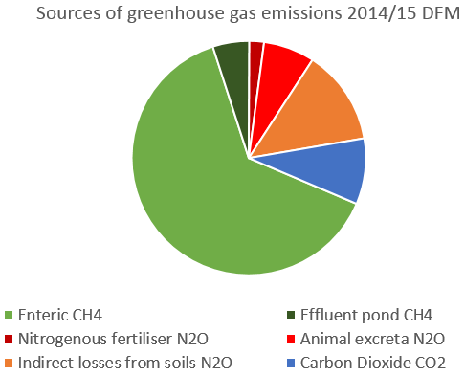
What does the data tell us?
Notes:
From 2013/14 DFMP report:
Methane (CH4) was identified as the main greenhouse gas emitted from dairy farms, accounting for 68% of all
greenhouse emissions. There are two main sources on farm: ruminant digestion and anaerobic digestion in effluent
management systems. Methane produced from ruminant digestion is known as enteric methane and was the major
source of emissions from all farms in this report, with an average of 63% of total emissions. Methane from effluent
ponds accounted for 5% of total emissions. The most efficient strategy to reduce enteric methane
production is manipulating the diet by increasing the diet quality through improved pastures and adding
concentrates. Adding fat supplements such as whole cotton seed and linseed oil into the diet can also reduce
methane emissions. This is simple and effective method however it is recommended that fats should not be more
than 6-7% of the dietary dry matter.
The second main greenhouse gas emission is nitrous oxide (N2O) accounting for 22% of total emissions or 2.5 t CO2e/t
MS. N2O emissions in dairy farms are sourced primarily from direct emissions; including nitrogen fertiliser application
and animal excreta (dung and urine), as well as indirect emissions such as that from
ammonia and nitrate loss in soils. Nitrous oxide emissions from fertiliser accounted for 2.4%
of total emissions, effluent ponds accounted for 0.1% and excreta accounted for 7.3%. N2O from indirect emissions were
12.5%. N2O emissions are greatest in warm, waterlogged soils with readily available nitrogen. Over application of nitrogen,
high stocking intensity and wet soils are all potential causes of increased nitrogen loss as N2O. Strategic fertiliser
management practices can reduce N2O emissions and improve nitrogen efficiency.
The third main greenhouse gas emission is carbon dioxide (CO2), which is produced primarily from fossil fuel
consumption as either electricity or petrochemicals. CO2 accounted for 9% of total emissions or 1.0 t CO2e/t MS.
Output levels were highly dependent on the source of electricity used with all farms using brown coal generated
electricity. Using renewable energy sources however, could cut electricity emissions significantly. There are also
a number of technologies available to improve energy efficiency in the dairy while reducing electricity costs.

Slide 4
What can we do to reduce emissions?
…check out the postcard
Notes:
Production improvement options and best management practices are most often linked to greenhouse gas emissions reduction. At present, well managed farms have few options to reduce emissions without significant changes to their farming or feeding system. With no formal incentive in place to reduce GHG emissions, Australian farmers should consider emissions reduction options that lead to productivity gains or have cost benefits. Any option should be looked at within the whole farm system.
A great deal of research is underway within the Australian dairy industry to decrease the release of methane and nitrous oxide from farming systems.
For most dairy businesses, the scale of the operation combined with the costs in implementing or monitoring an Emission Reduction Fund project make it economically unviable to implement farm abatement activities on the basis of carbon credit income alone.
Changes to on-farm activity will only be worth making if they bring productivity and profitability gains in their own right.
Fortunately, many activities that increase on-farm efficiency also increase farm profits while reducing emissions intensity. Dairy farmers should focus on efficiency improvements that will lead to profitable productivity improvements as this will give reduced emissions intensity as a by-product.
An example from current industry modelling is presented in the diet management fact sheet (http://www.dairyingfortomorrow.com/index.php?id=30), where feeding a high fat supplement over summer caused a net increase in farm profit of $8,676 due to increased milk production. ERF income would increase this by just $200 to $8,876 at a $5 / t carbon price, and to $9476 at a $20 / t carbon price. $560 at $13.95 to $9234 (increase of 7%)

Slide 5
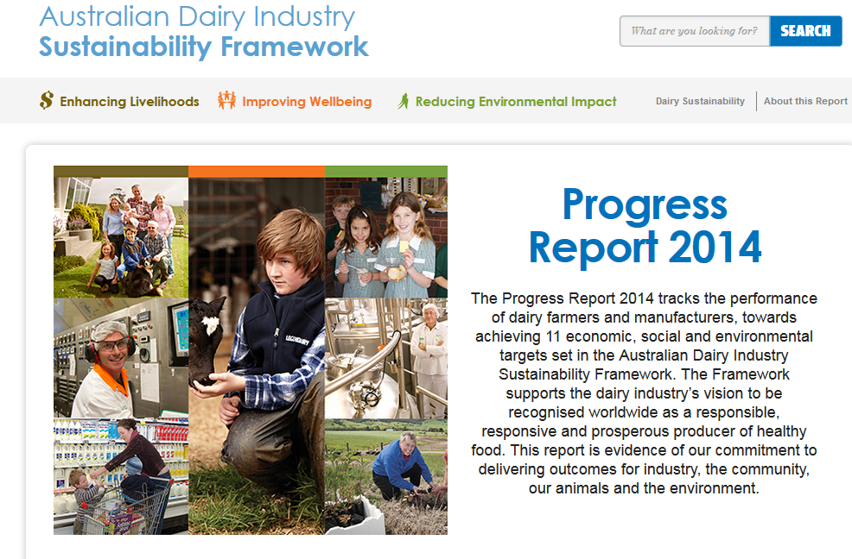
How is the data used?
The Australian dairy industry has committed to reducing its emissions intensity by 30% by the year 2020 based on the Australian Dairy Industry's Sustainability Framework.

