Slide 1
Irrigation System Efficiency – the Scott Wheatley Experience Centre Pivot & K Line Assessment
Presented by Matthew Plunkett and Peter Conasch

Slide 2
Irrigation Assessment Outcomes
Undertook two case study assessments
Compare irrigation efficiencies
Look for improvements
Identify scope to improve pumping energy efficiency
Centre Pivot and K-Line systems selected
Build on previous work conducted by NSW DPI

Slide 3
Scott’s Irrigation System

Slide 4
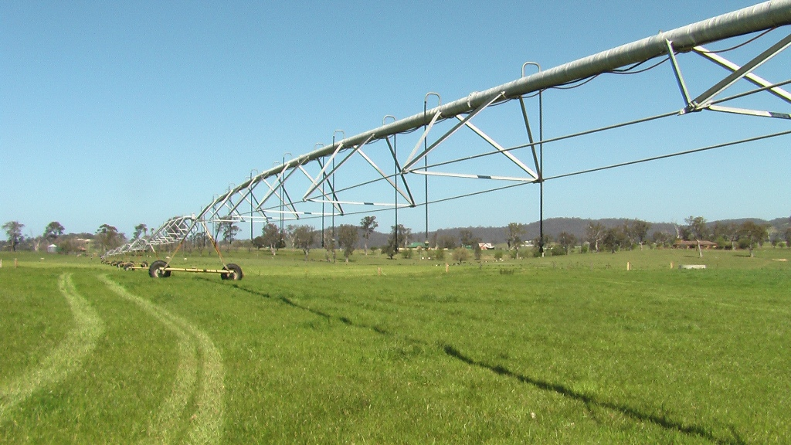
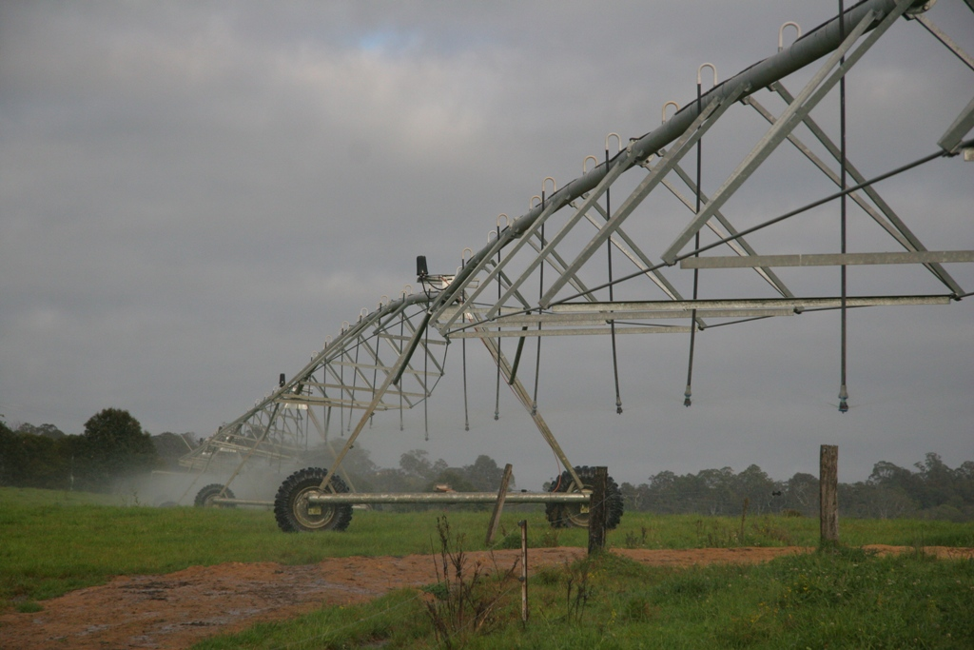
Concept of CP irrigation systems
About 1/10 labour of surface irrigation, 1/2 of LM
Dry ground is usually directly in front of machine
Low pressure operation
Sprinkler output increases as progress from pivot centre
End guns increase irrigable area at little extra cost

Slide 5
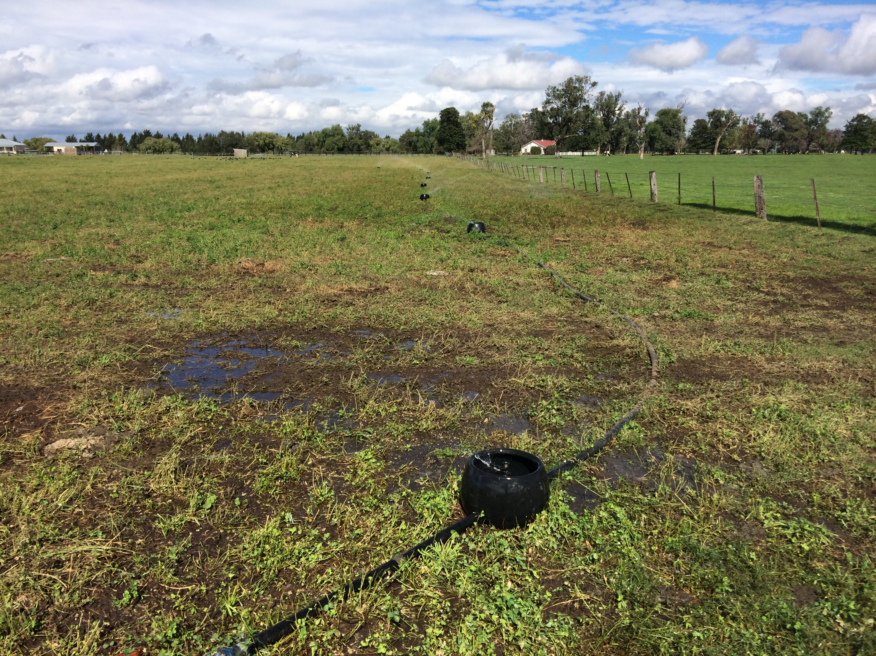
Concept of K-Line Systems
Low to medium pressure systems
Portable and adaptive to landscape and use
Labour intensive systems
Can be highly inefficient ie. pod and row placement is important for uniformity
Sprinkler selection is very critical

Slide 6
System evaluation and information gathering
Buckets (including rocks for ballast)
Pressure gauges (0-800kpa)
Measuring tape
Measuring cylinder
Field evaluation sheet
System design and/or sprinkler specification chart
Calculator
KMSI program for reporting or factsheet

Slide 7
System Evaluation
Step 1: Check components
General physical check of all components
no leaks or suction problems, and
that the number of outlets operating, their size and their pressure match the system design

Slide 8
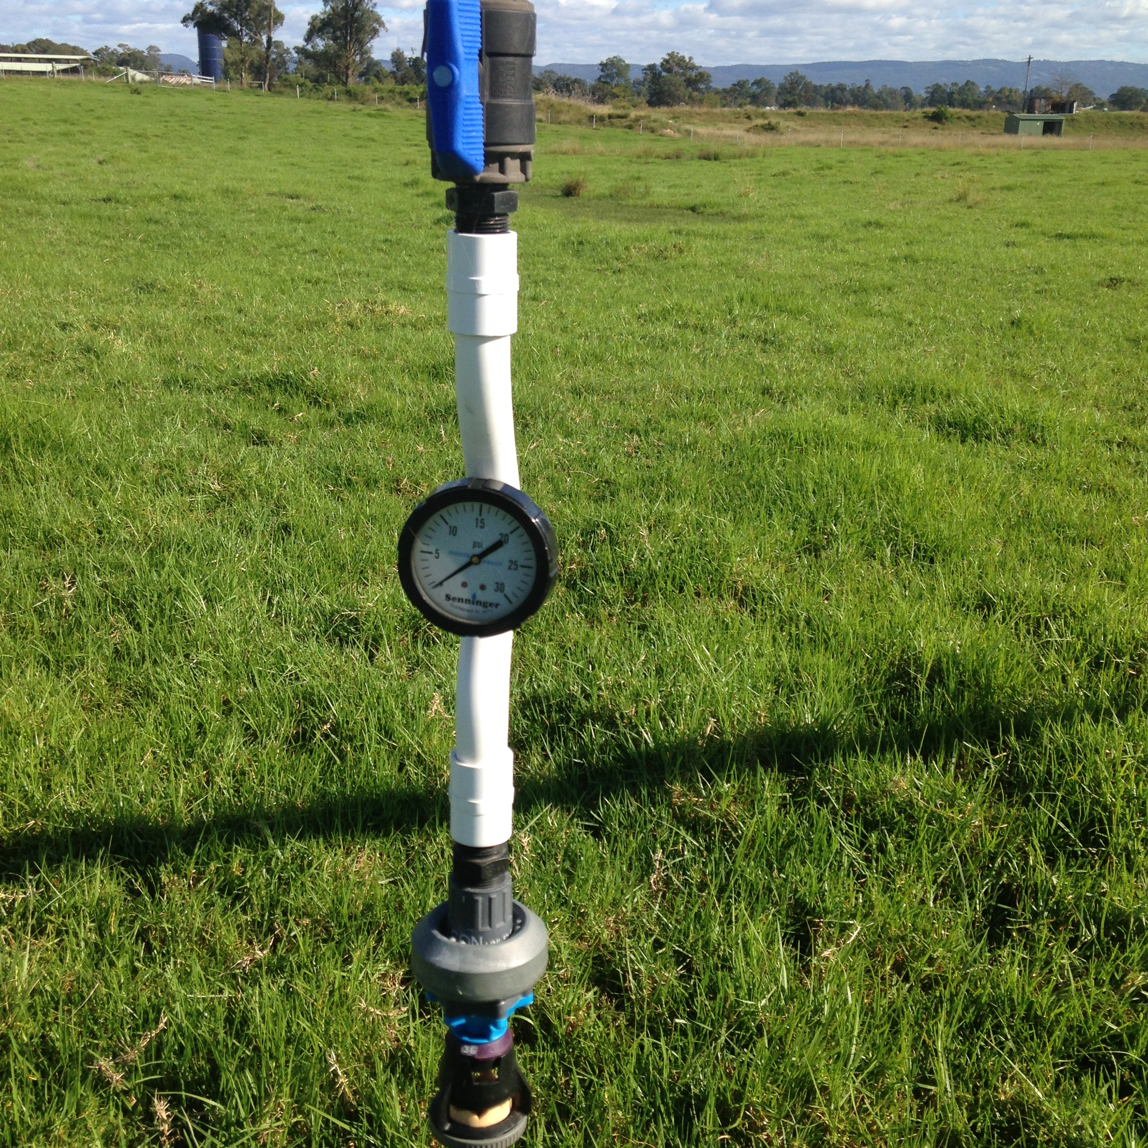
System Evaluation
Step 2: Measure pressure and flow
Check pressures and flows at various points within each block and across the whole system with the system operating in its normal configuration.

Slide 9
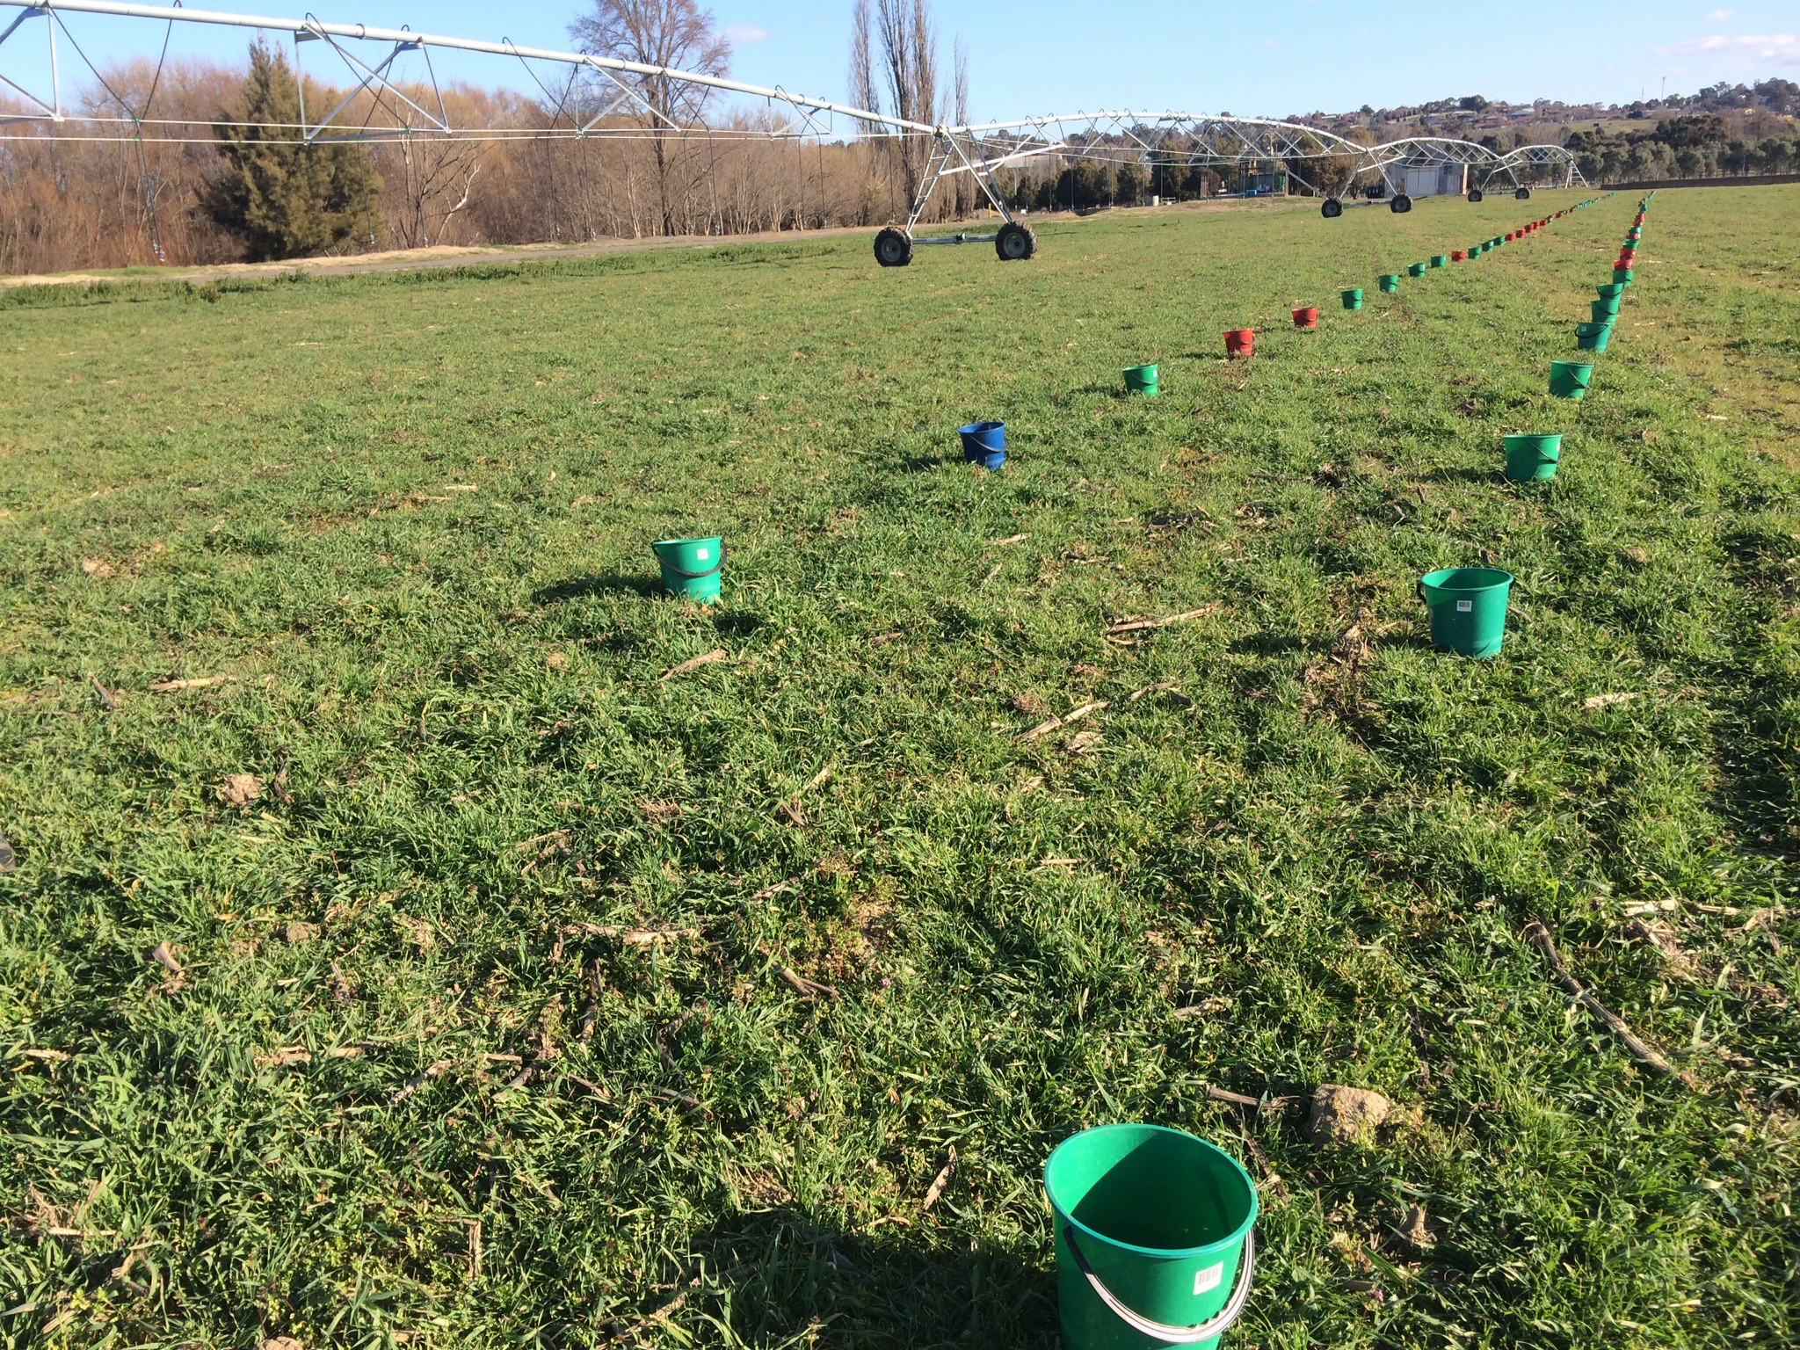
System Evaluation
Step 3: Measuring Mean Application Rate (MAR)
Catch cans are placed in the irrigated test area and the amount of water (mL) collected is measured, converted to a depth in mm, and then divided by the number of cans to give a MAR in mm/h.

Slide 10
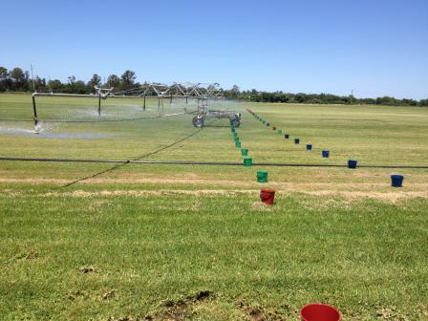
System Evaluation
Step 4: Measuring Distribution Uniformity (DU) or Coefficient of Uniformity (Pivots only)
When all the volumes have been converted to depths, the lowest 25% are selected. The average of the lowest 25% is divided by the MAR to give the DU figure.

Slide 11
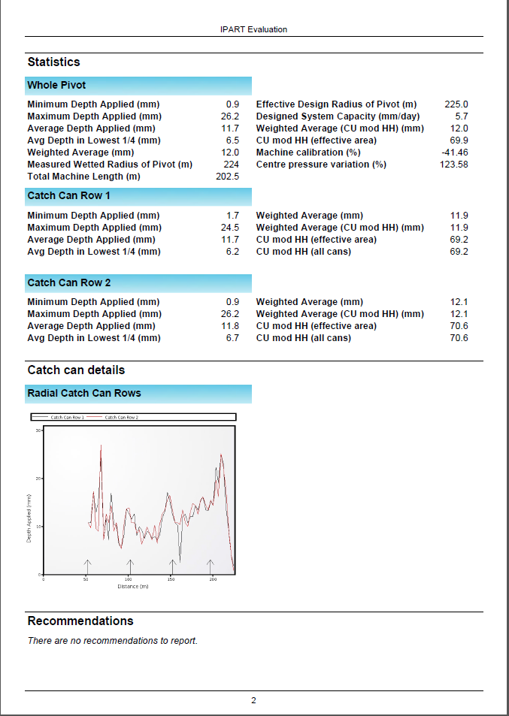
Results of the Centre Pivot Assessment

Slide 12
Results of the Centre Pivot Assessment
System is over pressurised which = $$$$$$$$$ 55PSI (379kpa)
Designed system capacity low (5.7mm)
Pivot designed to do 24 PSI (170kpa)
Co-efficient of uniformity 69% (acceptable)
Weighted Average Applied (12 mm) – set at 20mm!

Slide 13
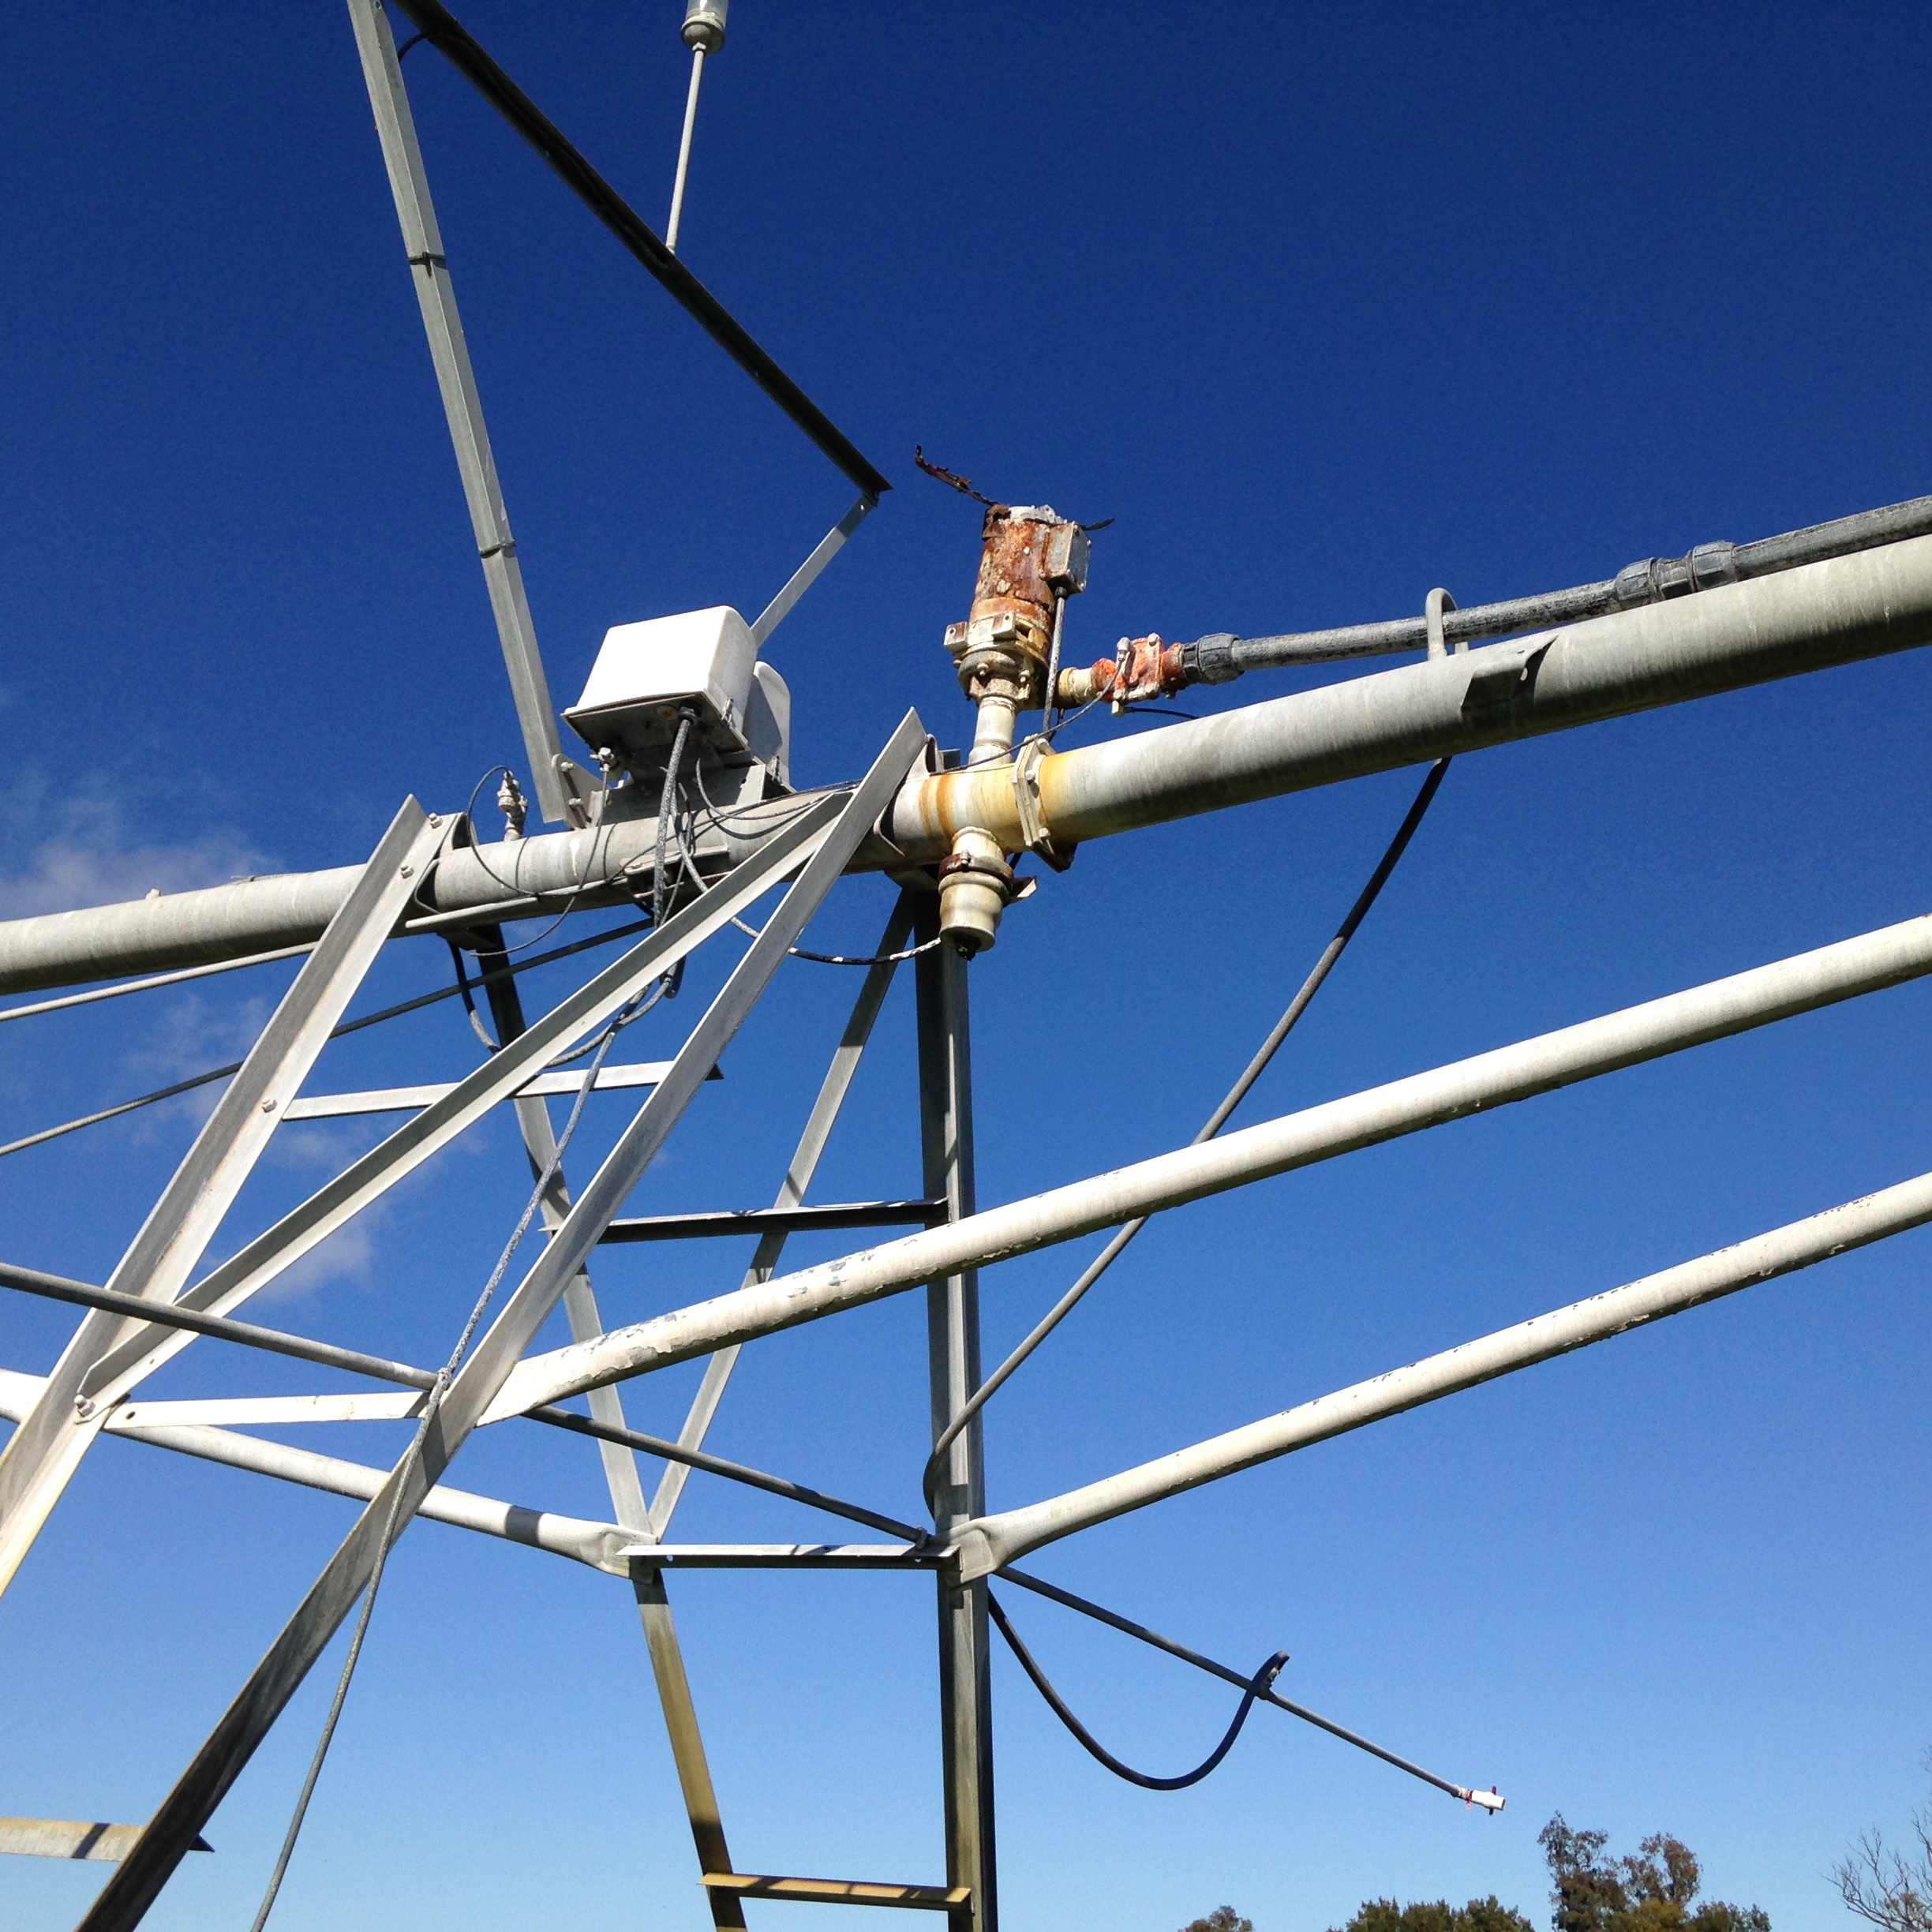
Recommendations for the Centre Pivot
Check sprinkler heads and maintain nozzles
Replace end gun to improve pivot performance
Monitor operating pressures
Consider upgrading pumps and mainlines to increase system capacity
Recommend a level 2 pumping
energy efficiency audit

Slide 14
Pressure costs
Pressure above regulator/sprinkler requirement little benefit & ongoing energy cost. ($5- $10/ML/10 psi)

Slide 15
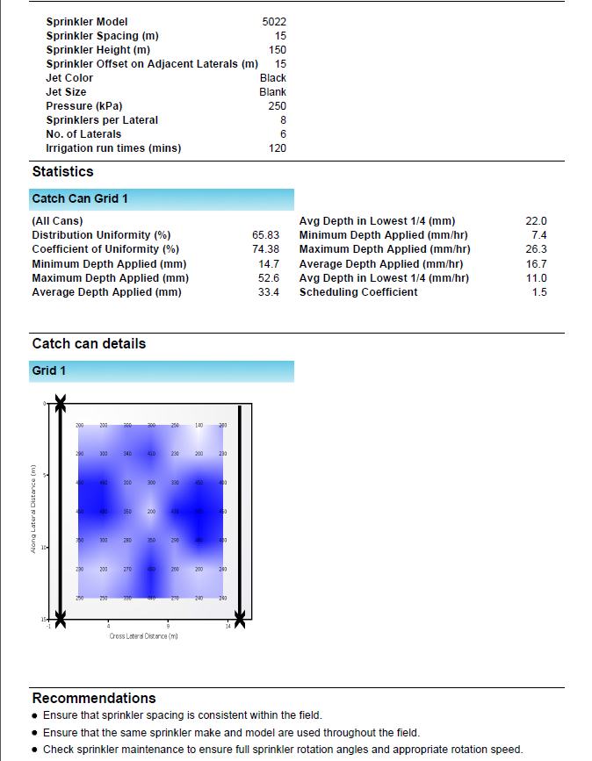
Results of the K Line Assessment

Slide 16
Results of the K Line Assessment
DU of 65% (acceptable)
Scheduling Coefficient 1.5 (100% uniform is 1)
Measure pressures at various locations

Slide 17
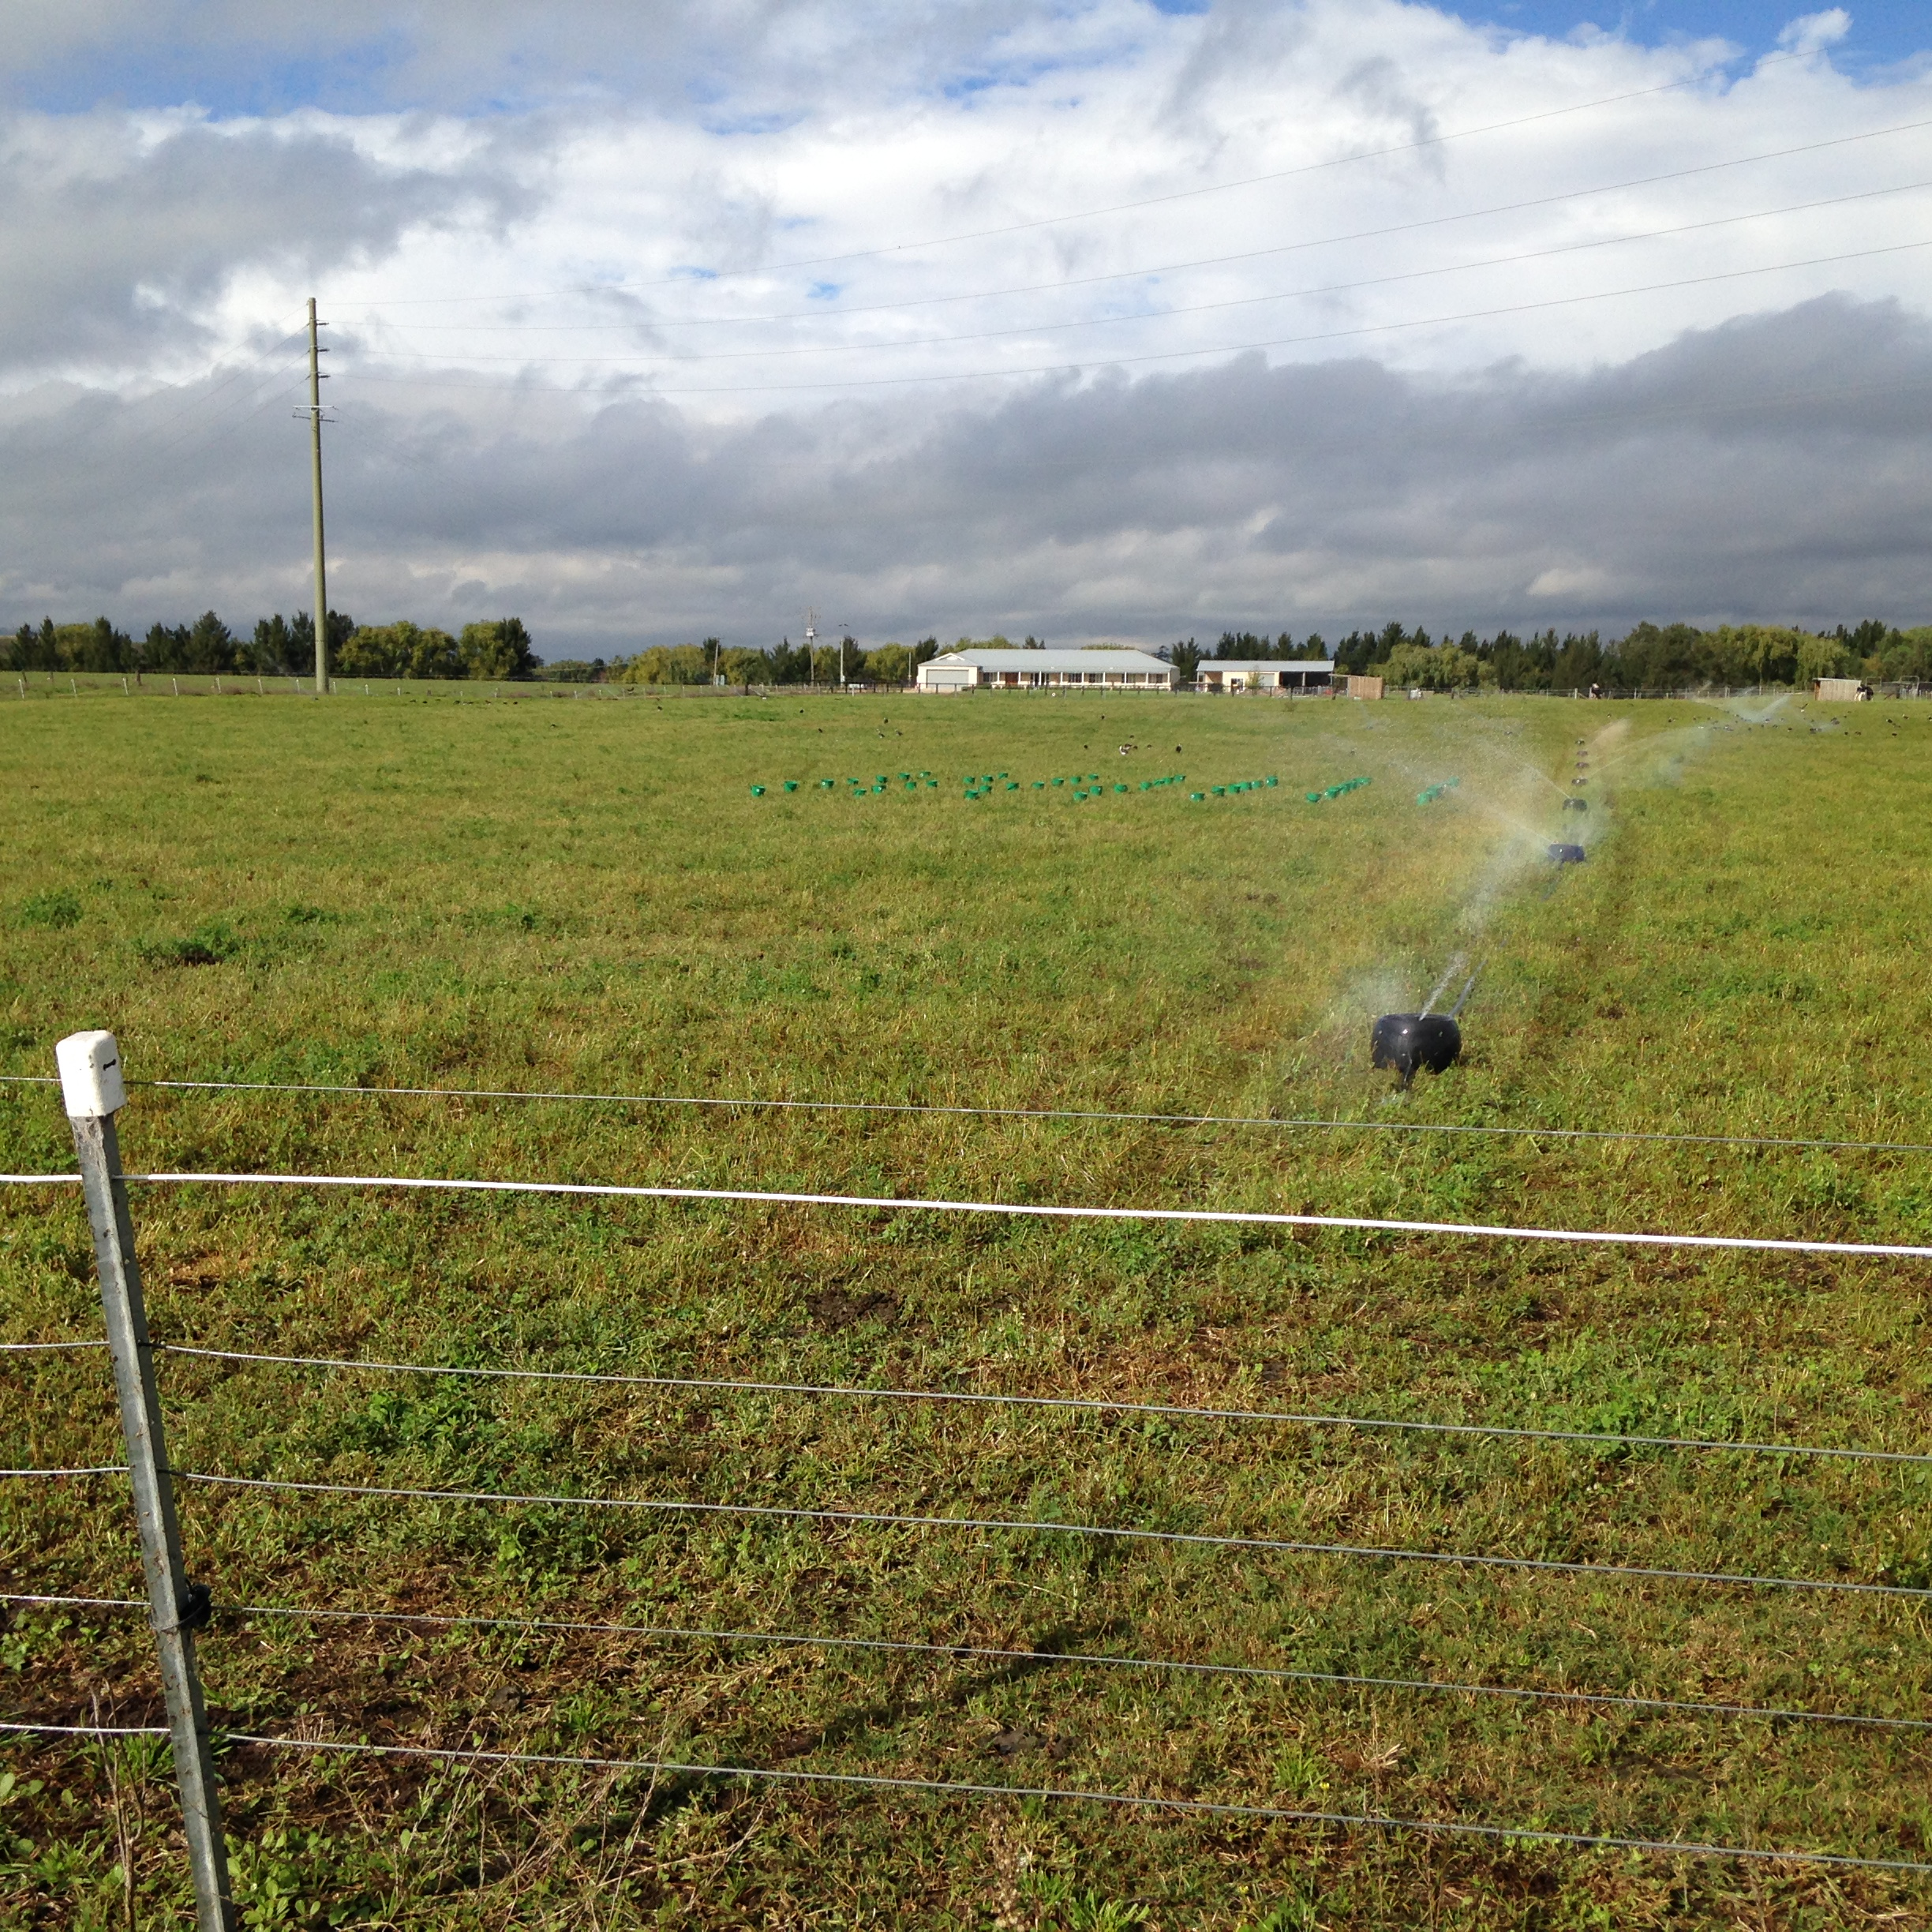
Recommendations for the K Line System
Ensure sprinkler spacing is consistent
Change lateral spacing from 15m to 12m to improve uniformity
Undertake regular sprinkler maintenance
Recommend a level 2 pumping
energy efficiency audit

Slide 18
Practice Change – Scott’s Experience
“We have looked at ways to alleviate the blocked nozzles by replacing the rusty bends.”
“We now only shift the k lines 12m in spacing, meaning 2 extra shifts but better coverage.”
“We are aware of the extra costs around peak time (pumping) and avoid it if possible.”

Slide 19
System Capacity for Centre Pivots
The system capacity is the maximum possible rate at which the machine can apply water to the irrigated field area
Expressed in mm/day
not mm applied per pass (mm)
Assumes irrigator is operating 24 hrs per day,
7 days a week, with no water losses (100% efficient)

Slide 20
Determining crop water requirement
Long term average evaporation data for region (BOM)
Calculate crop water requirement from evaporation data and & a calibration value specific to your crop referred to as “Crop co-efficient”
Refer to the month of greatest water use for the crop under consideration
If more than one crop, use the highest water use

Slide 21
Ideal System Capacity (example only)
January Point Potential evaporation is 230 mm
January has 31 days, so 230 ÷ 31 = 7.4 mm/day
Convert to your crop’s water use: multiply by crop coefficient (Kc) Eg. for lucerne, Jan Kc is 0.95
Peak average ETc = 7.4 x 0.95 =
7.0 mm/day – Design System Capacity (DSC)
Managed System Capacity (MSC)– uprate by the management issues:
PUR 71% (0.71), Application Eff (Ea) 0.95
Managed System Capacity is 7.0(DSC) ÷ 0.71(PUR) ÷ 0.95(Ea)= 10.4 mm/d
Kc: Crop coefficients is a factor to predict evapotranspiration (ET) in different crops.
DSC: Design system capacity is the maximum possible depth of water the irrigation system is capable of supplying to a given area in a given time
PUR: Pump running time in a seven day period, during peak time (expressed as a decimal)

Slide 22
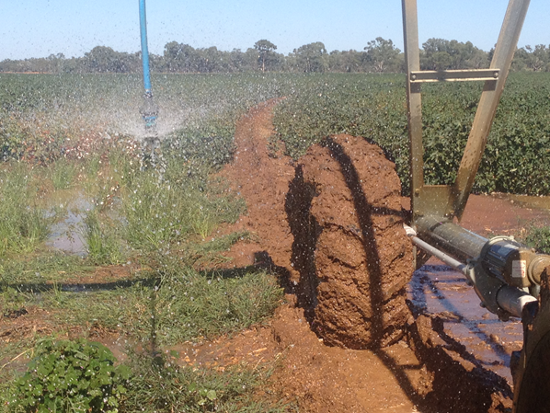
Common issues affecting performance
Poor system design and component selection
Sub-standard installation or assembly
Lack of commissioning of the system prior to hand over
Inadequate operation or maintenance

Slide 23
Irrigation scheduling resources
Bureau of Meteorology (BOM)
Greenbrain

Slide 24
THANK YOU!!
Matthew Plunkett
0428 978 390
matthew.plunkett@lls.nsw.gov.au
Peter Conasch
0427 741 956
peter.conasch@lls.nsw.gov.au

