Slide 1
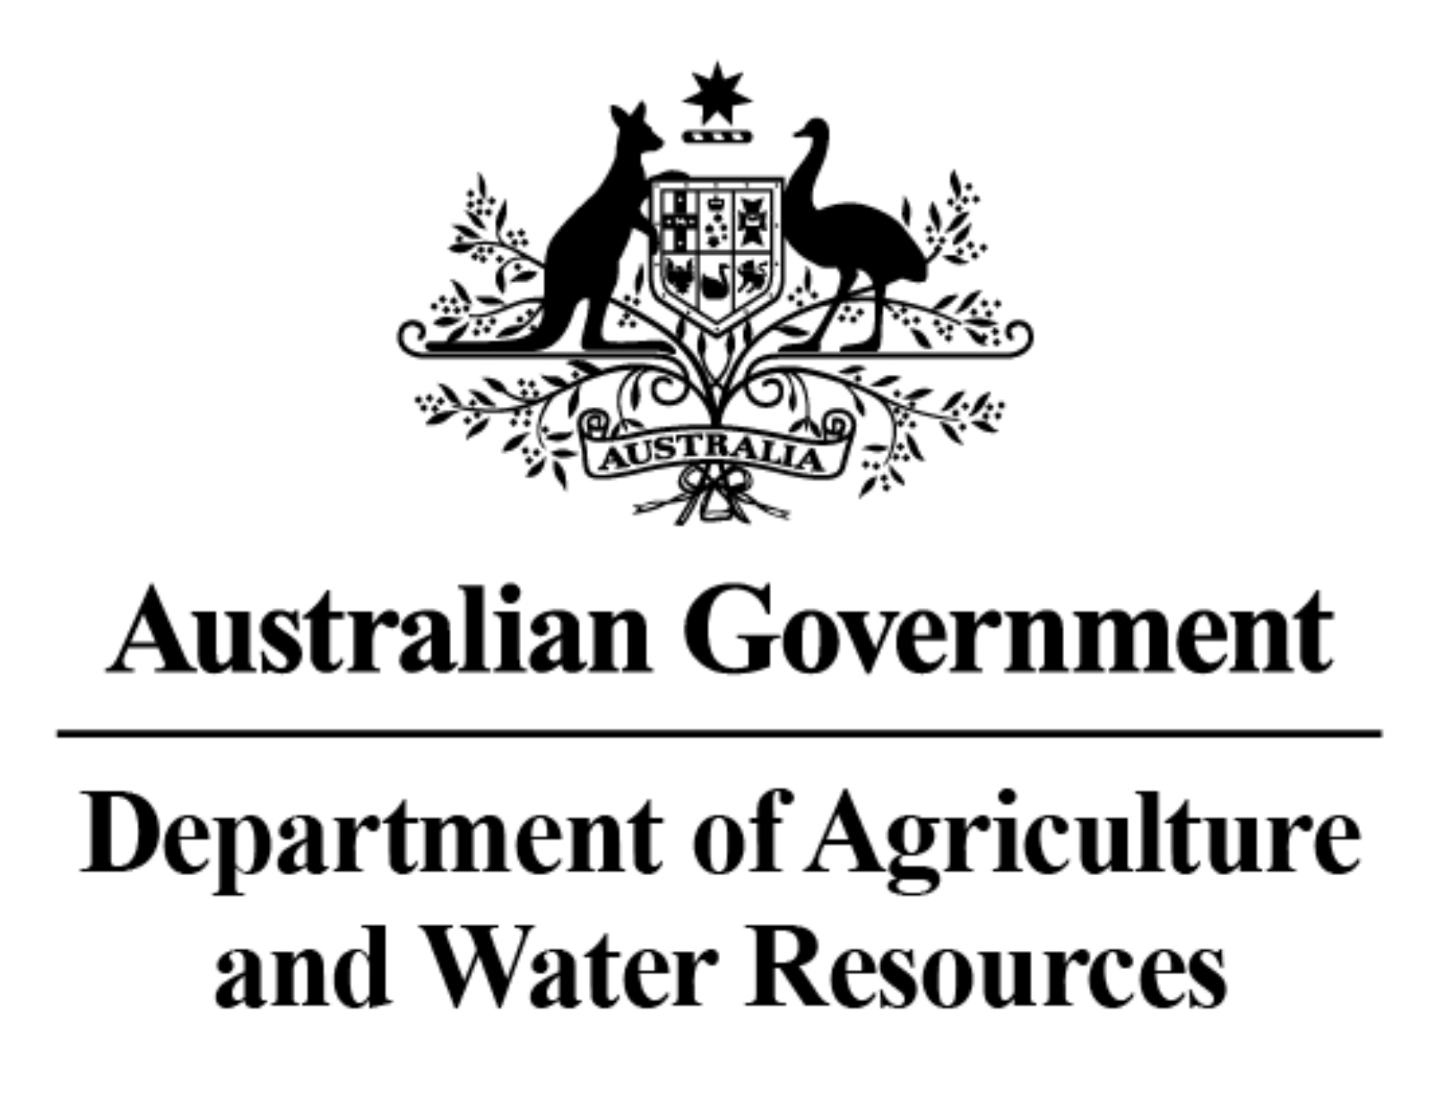
Preparing Australian Dairy Businesses for Extreme and More Variable Climates – a Research Project Integrating Economic, Biophysical and Social Aspects
Dr Brendan Cullen (Uni Melb)
on behalf of project team

Slide 2
Dairy Businesses for Future Climates
Managing climatic & economic volatility

Slide 3
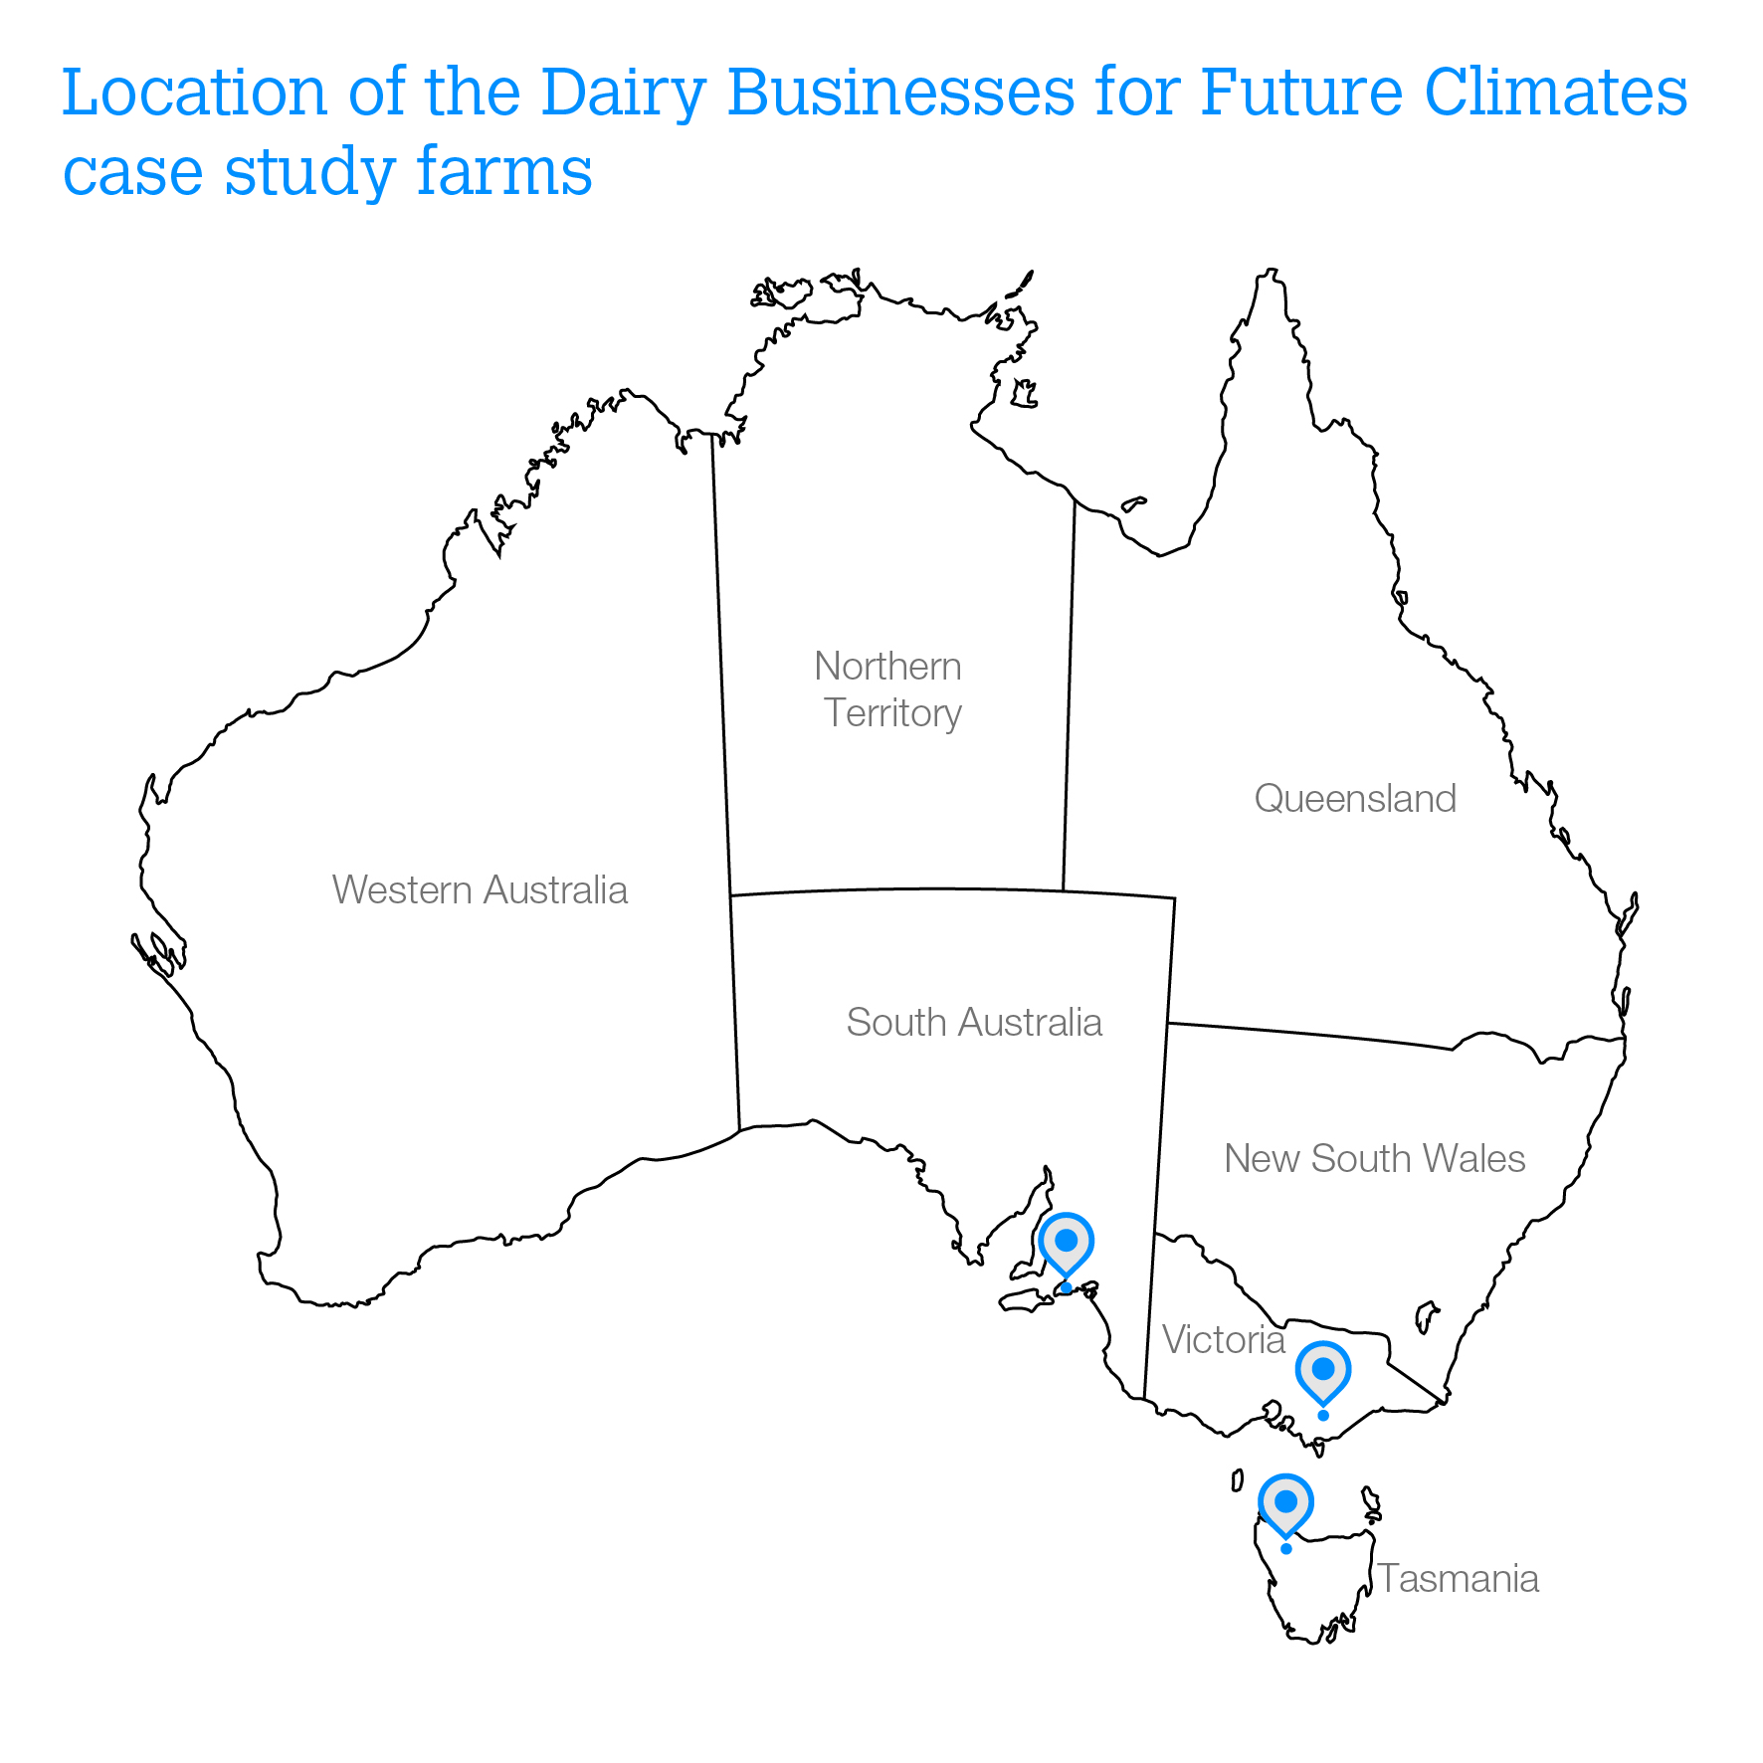
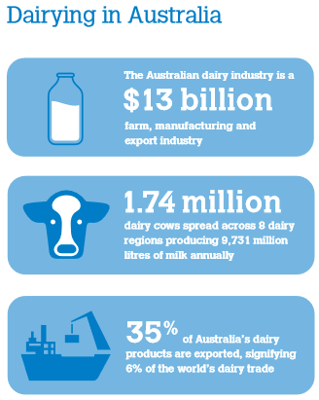
Dairy Businesses for Future Climates
3 case study or ‘base’ farms were selected – real data was collected to inform the models

Slide 4
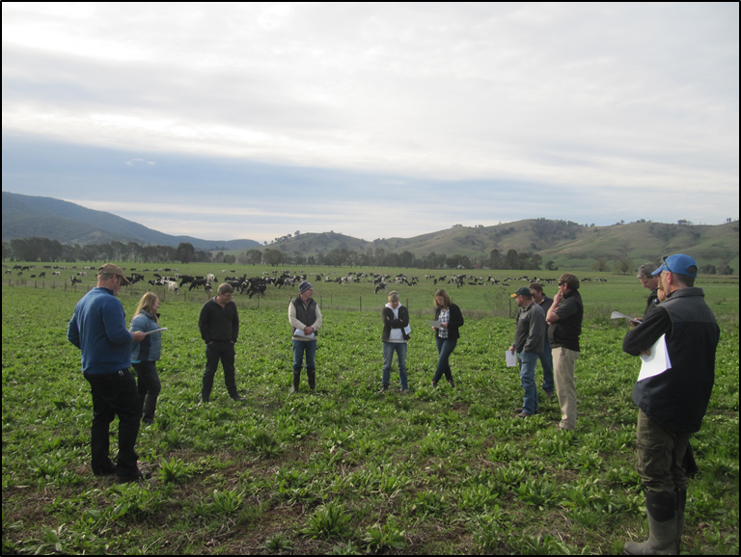
Dairy Businesses for Future Climates
Project Approach
Social
Economics
Biophysical

Slide 5
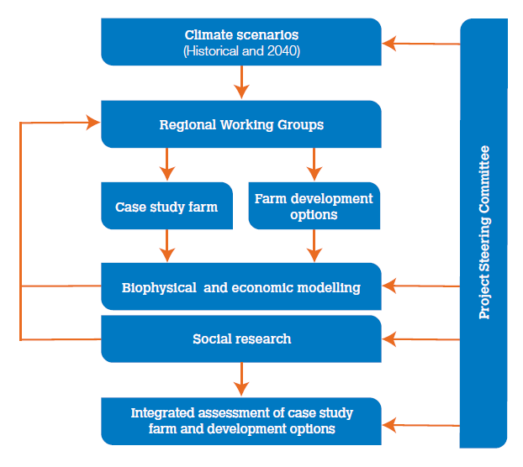
Dairy Businesses for Future Climates
Project Approach

Slide 6
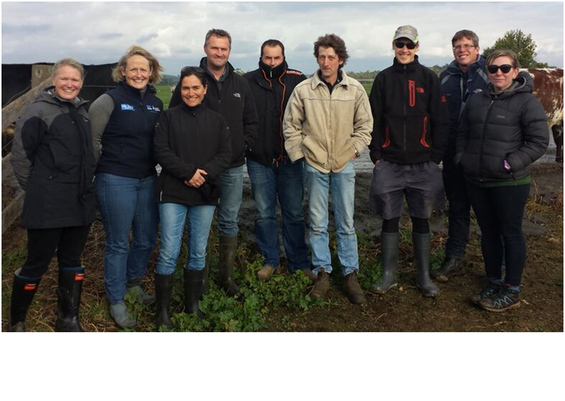
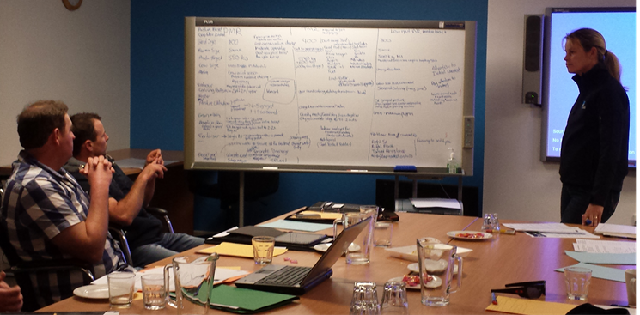
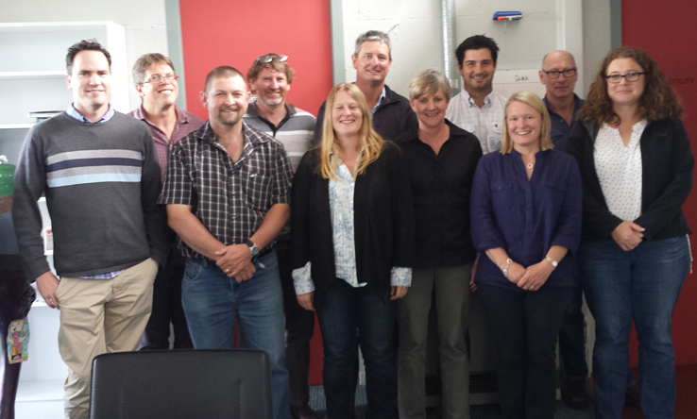
Dairy Businesses for Future Climates
Regional Working Groups
Checking in on the figures
Guiding the research
Notes:
Regular farm meetings to get feedback on every step of the research

Slide 7
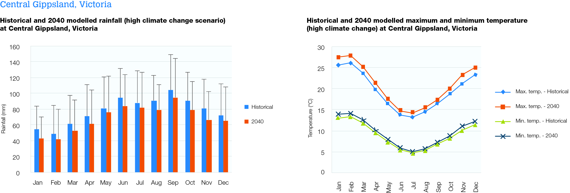
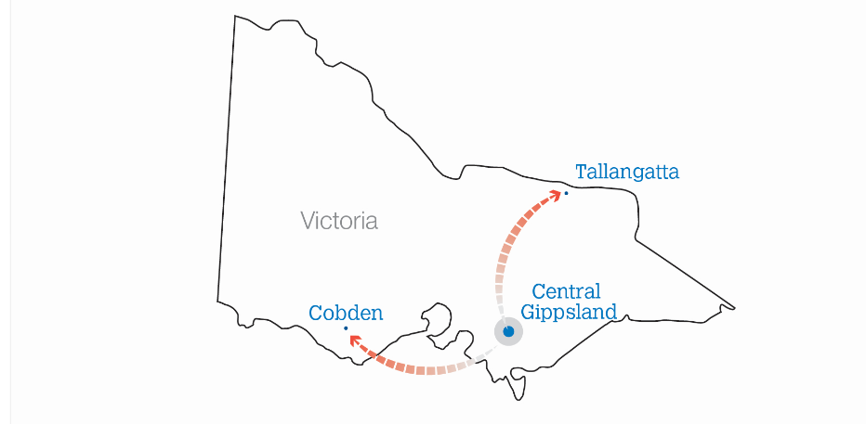
Dairy Businesses for Future Climates
In 2040 under the High climate change scenario, the climate of central Gippsland will be more like Tallangatta (without the temperature extremes) or Cobden (but warmer).

Slide 8
Dairy Businesses for Future Climates
What were the farm options used in the research?
Gippsland
Base farm:
350 milking cows (3.2 cows/ha milking area)
Spring calving
Grain feeding 1.1 t/cow per year
Production of 395 kg milk solids/cow per year

Slide 9
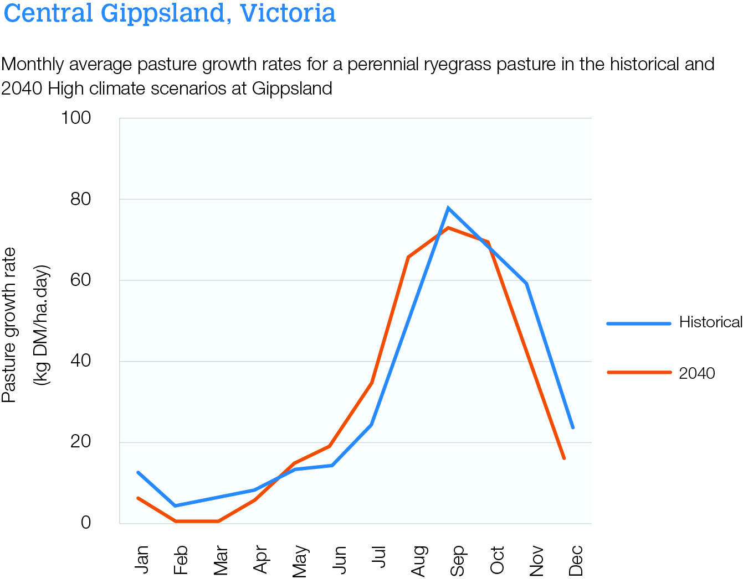
Dairy Businesses for Future Climates
Future pasture growth patterns
The growing season for pastures will shift under 2040 climate change scenarios creating feed challenges.
Reduced summer & late spring growth
Increased Winter and early Spring growth
Lower Spring peak
More Summer cropping?
More brought in feed?
More feed conserved & fed out?

Slide 10
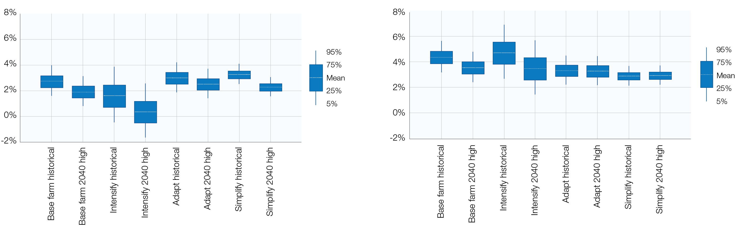
Dairy Businesses for Future Climates
Results – what did we learn?
Gippsland – Internal rate of return (%) over 10 year periods
‘Dry’ 10 year period
‘Wet’ 10 year period
8%
6%
4%
2%
0%
-2%
8%
6%
4%
2%
0%
-2%
Base farm – historical
Base farm – 2040 High
Intensify – historical
Intensify – 2040 High
Adapt – historical
Adapt – 2040 High
Simplify – historical
Simplify – 2040 High
Base farm – historical
Base farm – 2040 High
Intensify – historical
Intensify – 2040 High
Adapt – historical
Adapt – 2040 High
Simplify – historical
Simplify – 2040 High
Base farm – historical
Base farm – 2040 High
Intensify – historical
Intensify – 2040 High
Adapt – historical
Adapt – 2040 High
Simplify – historical
Simplify – 2040 High
Base farm – historical
Base farm – 2040 High
Intensify – historical
Intensify – 2040 High
Adapt – historical
Adapt – 2040 High
Simplify – historical
Simplify – 2040 High

Slide 11
Dairy Businesses for Future Climates
Results – what did we learn?
Gippsland – Internal rate of return (%) over 10 year periods
‘Dry’ 10 year period
‘Wet’ 10 year period
8%
6%
4%
2%
0%
-2%
8%
6%
4%
2%
0%
-2%
Base farm – historical
Base farm – 2040 High
Intensify – historical
Intensify – 2040 High
Adapt – historical
Adapt – 2040 High
Simplify – historical
Simplify – 2040 High
Base farm – historical
Base farm – 2040 High
Intensify – historical
Intensify – 2040 High
Adapt – historical
Adapt – 2040 High
Simplify – historical
Simplify – 2040 High
Base farm – historical
Base farm – 2040 High
Intensify – historical
Intensify – 2040 High
Adapt – historical
Adapt – 2040 High
Simplify – historical
Simplify – 2040 High
Base farm – historical
Base farm – 2040 High
Intensify – historical
Intensify – 2040 High
Adapt – historical
Adapt – 2040 High
Simplify – historical
Simplify – 2040 High

Slide 12
Dairy Businesses for Future Climates
Results – what did we learn?
Gippsland – Internal rate of return (%) over 10 year periods
‘Dry’ 10 year period
‘Wet’ 10 year period
8%
6%
4%
2%
0%
-2%
8%
6%
4%
2%
0%
-2%
Base farm – historical
Base farm – 2040 High
Intensify – historical
Intensify – 2040 High
Adapt – historical
Adapt – 2040 High
Simplify – historical
Simplify – 2040 High
Base farm – historical
Base farm – 2040 High
Intensify – historical
Intensify – 2040 High
Adapt – historical
Adapt – 2040 High
Simplify – historical
Simplify – 2040 High
Base farm – historical
Base farm – 2040 High
Intensify – historical
Intensify – 2040 High
Adapt – historical
Adapt – 2040 High
Simplify – historical
Simplify – 2040 High
Base farm – historical
Base farm – 2040 High
Intensify – historical
Intensify – 2040 High
Adapt – historical
Adapt – 2040 High
Simplify – historical
Simplify – 2040 High

Slide 13
Dairy Businesses for Future Climates
Results – what did we learn?
Gippsland – Internal rate of return (%) over 10 year periods
‘Dry’ 10 year period
‘Wet’ 10 year period
8%
6%
4%
2%
0%
-2%
8%
6%
4%
2%
0%
-2%
Base farm – historical
Base farm – 2040 High
Intensify – historical
Intensify – 2040 High
Adapt – historical
Adapt – 2040 High
Simplify – historical
Simplify – 2040 High
Base farm – historical
Base farm – 2040 High
Intensify – historical
Intensify – 2040 High
Adapt – historical
Adapt – 2040 High
Simplify – historical
Simplify – 2040 High
Base farm – historical
Base farm – 2040 High
Intensify – historical
Intensify – 2040 High
Adapt – historical
Adapt – 2040 High
Simplify – historical
Simplify – 2040 High
Base farm – historical
Base farm – 2040 High
Intensify – historical
Intensify – 2040 High
Adapt – historical
Adapt – 2040 High
Simplify – historical
Simplify – 2040 High

Slide 14
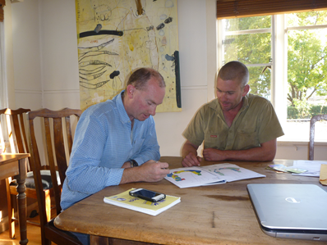
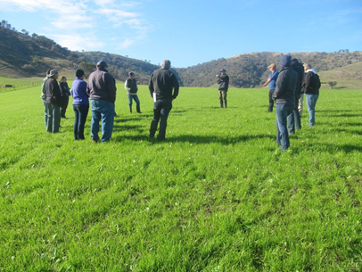
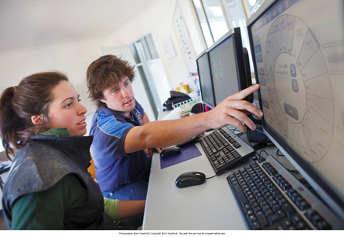
Dairy Businesses for Future Climates
Social research findings
Climate challenges do not appear to be the key deciding factor in current dairy business development planning.
Each option has both opportunities and vulnerabilities, and will involve trade-offs relative to each farming situation.
Dairy business managers are generally confident in their ability to adapt to incremental climate challenges. Future climate change was assumed to be incremental, foreseeable and economically viable.
Notes:
Generally, farmers are confident in ability to manage current and near future climate challenges – they have always done.

Slide 15
Dairy Businesses for Future Climates
The Productivity Challenge
Annual rate of productivity growth required to maintain profitability in 2040 High scenario:
Fleurieu Peninsula = 0.6% per year
Gippsland = 0.6% per year
Tasmania = 0.3% per year
Dairy annual productivity growth = 1.6% (ABARES)
Climate Change is a substantial additional challenge (on top of business as usual).

Slide 16
Dairy Businesses for Future Climates
Key Findings
1. The profitability of dairy farm businesses in this research was negatively affected by the 2040 climate change scenarios modelled. Three real base farms and three development options at each site were tested.
2. Farmers interviewed were generally confident to adapt to incremental climate change based on their past experiences of managing variable seasons.
3. Dairy Farm managers will need to continue to adapt their farm systems to manage risks presented by future climate.
4. The adaptive or simplified farm production systems tested are realistic alternatives to the long term trend of intensification for dairy businesses in future climates.

Slide 17
Heading Here
Further information
Website: http://www.dairyclimatetoolkit.com.au/adapting-to-climate-change/adapting-the-dairy-industry
Catherine Phelps, Dairy Australia NRM Program Manager
Acknowledgements
Funding
Dairy Australia & The Australian Government
Research Team
Dan Armstrong, D-Arm Consulting
Brendan Cullen, Margaret Ayre, Nicole Reichelt, Steven Waller, Ruth Beilen, Ruth Nettle, University of Melbourne
Richard Rawnsley and Matthew Harrison, Tasmanian Institute of Agriculture
Regional Coordinators & Working Groups
Monique White, Rachel Brown and Gillian Hayman
Thank you to the dairy farmers and farm advisors who made up the Working Groups in each region

